Slide 1
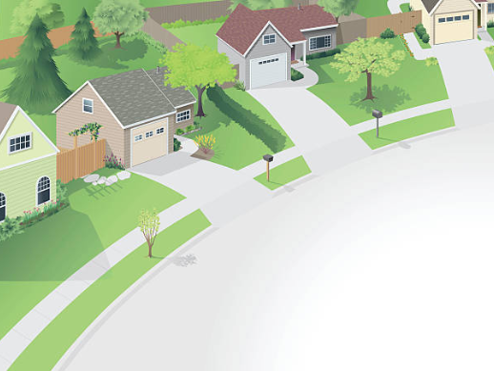

Ames Housing
Price Prediction
Group 6:
Kenny Lim
Kua Kee Chuah (KC)
Lester Phong

Slide 2
Agenda
Opening Statement
What goes into Housing Prices
Analysis of Housing Data
Machine Learning Model Findings
Conclusion & Recommendations

Slide 3


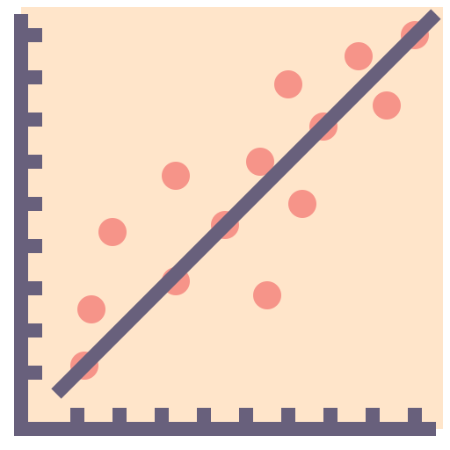
Quantum Realty: New Direction
Q
RE A LTY
Data Driven
Investing in High Margin Property
Machine Learning
Icon by Flat Icons from www.flaticon.com
Icon by Smash Icons from www.flaticon.com
Notes:
Good morning boardmembers and shareholders, thank you for joining us for this meeting today
We are the data science team behind Quantum Realty Investment.
The company is moving in a new direction that is evidence based and data driven.
The goal of the company remains the same which is to buy undervalued houses and flip them for a profit.
The difference is that we have utilised several machine learning models to help us identify properties with high opportunities

Slide 4



Opening Statement
Target Market: Ames, Iowa
Home to a population of 67,154
High Accuracy Predictions
Identify High Demand Features
Development
Potential
How close is our predicted sale price of a house in Ames?
Which features of a property have the strongest impacts on housing prices?
Notes:
Ames is a city in Story County, Central Iowa.
Current tools have been ineffective in helping the investment teamt decide on a property in Ames as there are many factors which would affect housing prices. It is difficult for to dicipher such complexity and translate the data into useful information for decision making.
The data science team has created a regression model constructed based on Ames Housing Data. This model has been able to produce high accuracy predictions.
With the ability to mirror the market, we also able to help explain how different variables affect housing prices and predict the price of a house in Ames.
Ultimately, our investment will then be able to discover undervalued properties in Ames as they uncover the answers to the following problems:
* Which features of a property are important in predicting sale prices of houses in Ames?
* What is the predicted sale price of a house in Ames based on its features?

Slide 5


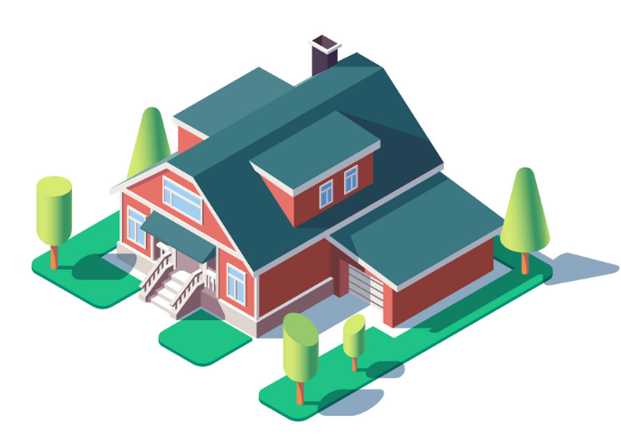
2. What goes into the AMES Housing Prices
Location
Property size
General Conditions
Amenities
Bathrooms?
Bedroom Number?
Some examples….
Interior Condition?
Ground Floor Size?
Storey or level?
Exterior?
Living room?
Pool?
Street?
Garage?
Floor Area?
Lot Area?
Notes:
When we think about choosing a house or a home, there are several factors that immediately pop to mind
Location
Property Size
General Conditions
Amenities
With these in mind, we started to look into our dataset to find factors such the square footage of the property, the number of bedrooms, number of storeys, neighborhood etc.
Here are some examples of the attributes of that we would be looking at. From a list of 80 features, we would be narrowing them down to the key factors to address.
Now we will have KC walk you through our exploratory data analysis and feature selection process.

Slide 6


Data Cleaning
3. Analysis of Housing Data
Incomplete Data
Feature Overload
over 8,000 missing values!
80 Original Features

Slide 7
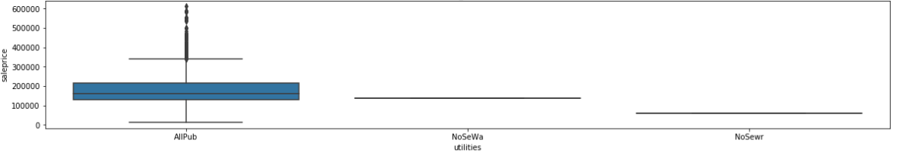
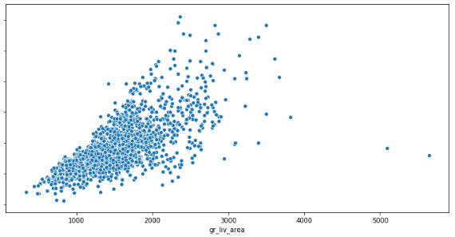
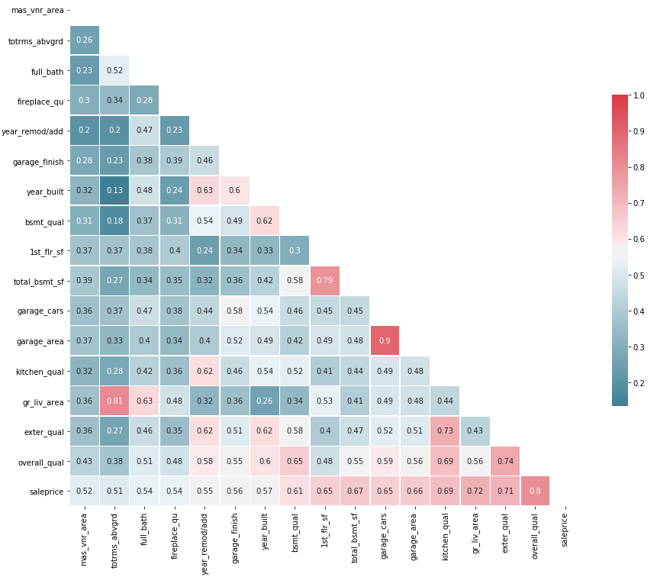
3. Analysis of Housing Data
Identifying Statistically Insignificant Features
1
Identifying Outliers
Identifying Correlated Features
2
80 44
final factors
3
Notes:
I would break this up
Too much in 1 slide

Slide 8
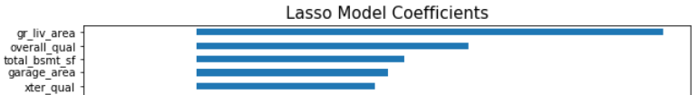
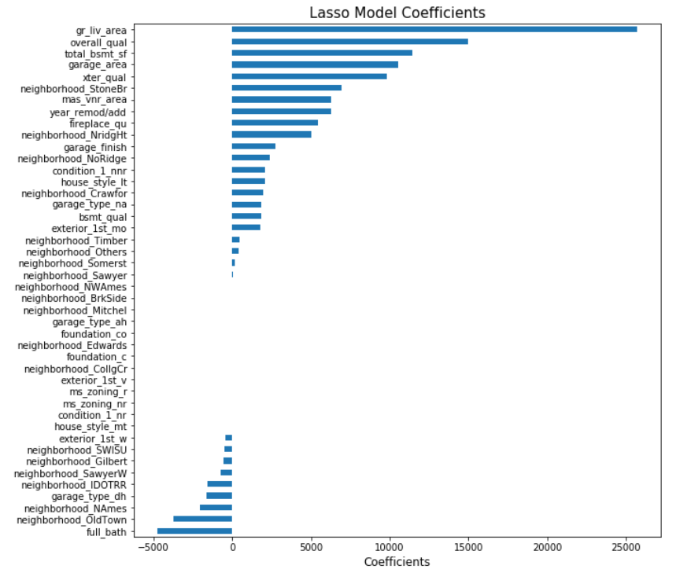
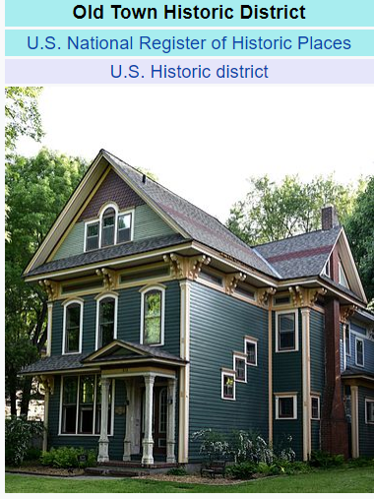
3. Analysis of Housing Data
Feature Selection
Top 5 features with
the greatest impact on housing prices.
Size Matters
Quality Matters

Slide 9

4. Findings
Findings
Quality Counts
Overall material and finish quality of the house
Exterior material quality
Popular Neighbourhoods
Stone Brook Northridge preferred
Key
Findings
When was property last renovated?
Remodel year (or construction date)
Size Matters
Above grade (ground) living area in square feet
Total square feet of basement area
Size of garage in square feet
Garage

Slide 10
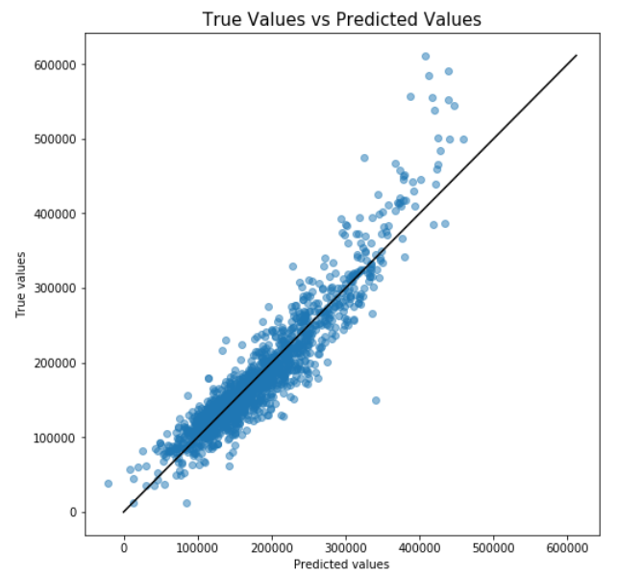
4. Findings
Model Performance
Good <= USD 400,000
Not So Good > USD 400,000

Slide 11




5. Conclusion & Recommendations
Findings
Why were these features strong predictors?
Above Ground & Basement Size
Quality /
Build Year
Garage
(& Size)
Neighbourhood
(Stone & North-R)
Utility
Value
Climate
Ownership
Mode
Protection
University
Facilities
Work
Integrity
Newness
Value

Slide 12




5. Conclusion & Recommendations
Findings
Stay Clear
Townhouses Or
Planned Unit Development
(PUD)
Less Desirable Neighbourhoods
Too many repeated features

Slide 13





5. Conclusion & Recommendations
Findings
What next?
Get more Demographic Info
Examine Crime Rates
Examine notable geographic establishments
Economic Factors

Slide 14
Thank you for your attention
Any Questions?

Slide 15
References
https://www.google.com/search?q=no+of+cars+per+family+in+ames&rlz=1C1CHBF_enSG888SG888&oq=no+of+cars+per+family+in+ames&aqs=chrome..69i57.7554j0j7&sourceid=chrome&ie=UTF-8
https://www.google.com/search?q=tornado+risk+in+ames&rlz=1C1CHBF_enSG888SG888&oq=tornado+risk+in+ames&aqs=chrome..69i57j33.3742j1j9&sourceid=chrome&ie=UTF-8
https://en.wikipedia.org/wiki/Old_Town_Historic_District_(Ames,_Iowa)
https://worldpopulationreview.com/us-cities/ames-population/

